Slide 1

PROBABILITY
Set and Operation
Venn Diagram
Word Problems

Slide 2
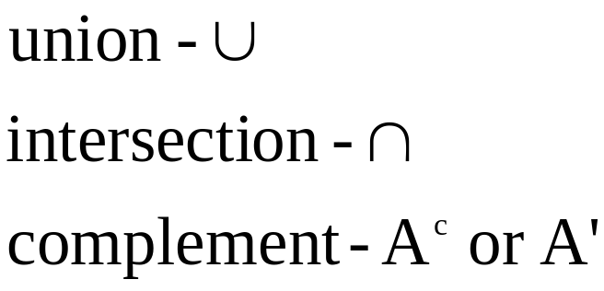

Set and Operation
Operation on set are:
Union = The union of sets A and B is those elements
which are in set A or set B or both
Intersection = The intersection of sets A and B is those
elements which are in set A and set B
Complement = complement of set A is those elements
not in set A

Slide 3
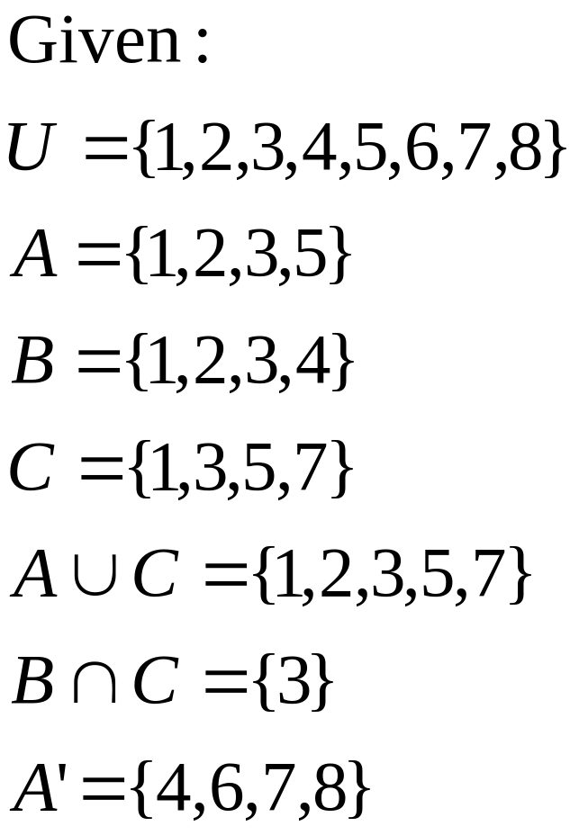
Set and Operation
Example:

Slide 4
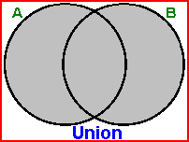
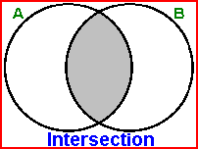
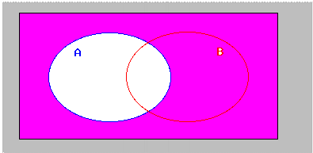
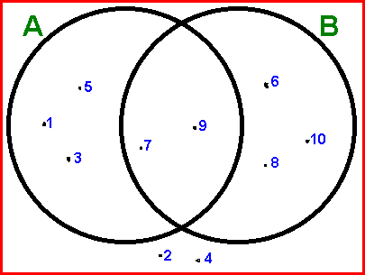
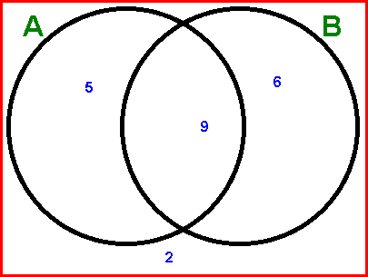

Venn Diagram
A Venn diagram is used to represent sets pictorially
how to interpret the information from Venn diagram?
Example..

Slide 5
Venn Diagram
We can see that all ten original numbers appear in the diagram.
The elements in the left circle are Set A
{ 1 , 3 , 5 , 7 , 9 }
The elements in the right circle are Set B
{ 6 , 7 , 8 , 9 , 10 }
The numbers of elements in Set A,
n(A) = 5 + 9 = 14
The numbers of elements in Set B,
n(B) = 6 + 9 = 15
The number of elements in set A and B
= 9
Example..

